Slide 1
Unity Development Project
Interactive Media
Unit 1

Slide 2
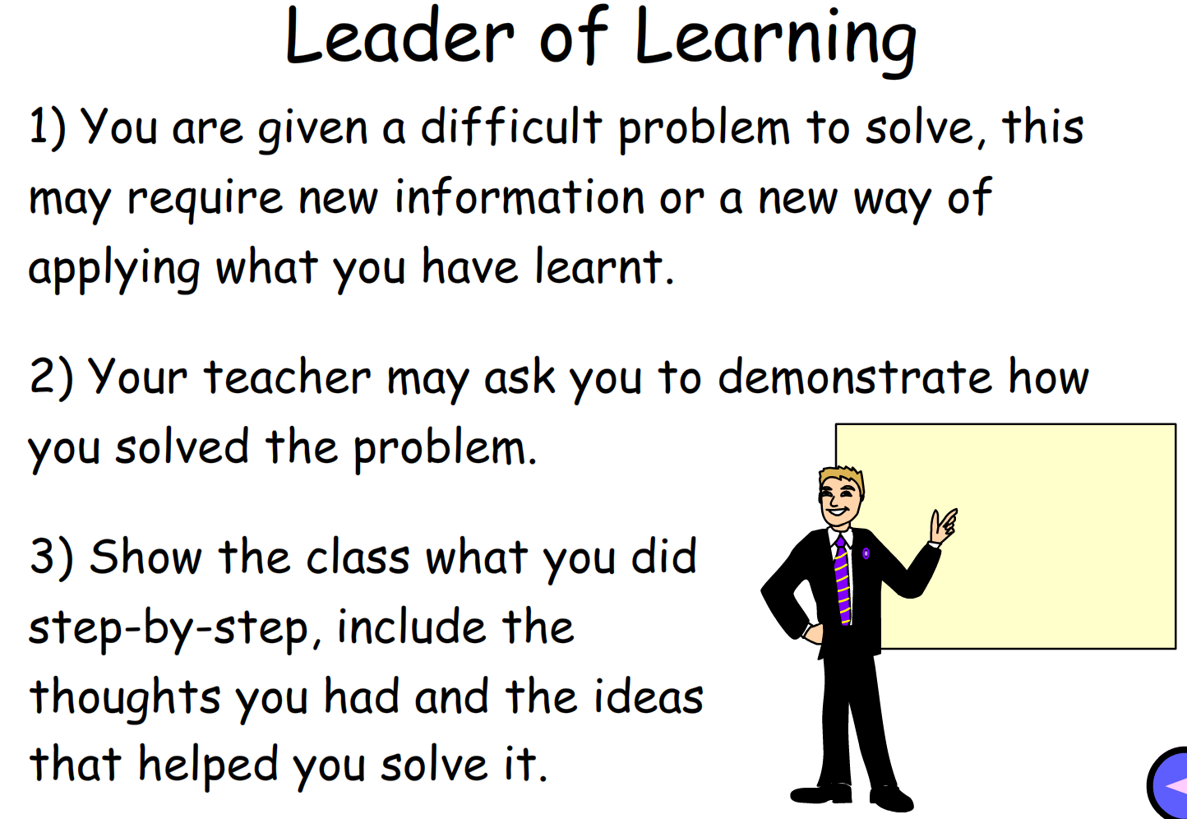
Starter – 5 Minutes
Discuss the following with your neighbours, be prepared to share your answer.
What is the purpose of Unity? What can it be used for?
What skills are required in producing a product in Unity?

Slide 3

Learning Outcomes
Aspire to ……
 | Explain the decisions made with VG development to produce a product with a specific brief.
Challenge to……
 | Describe how to produce a product that fits the given requirements.
 | Understand the requirements of a brief and use it to create a product.

Slide 4
Experimenting with Techniques
The best way to learn from the skills you have been given is to experiment with them.
To do this, you will be given a brief that will outline what is expected as a result of your experimentation.
You will then need to use what you have learnt and more to complete the project.
Use the tutorials you were given to aid your work.

Slide 5

Task 1 – Game Production
Previously, you produced a poster mood board and a movie-style poster for children 5-10 on one of the following topics: (Education, Technology, Science, Music)
Using Unity, create a game that fits to your chosen topic. More information in the worksheet.
Explain the programming you have done for the game.
Are there changes you want to make that you don’t have the skills for yet?
Explain how your game fits to the brief.
Use and modify either the 2D or 3D game you made previously.
Challenge D

